Slide 2
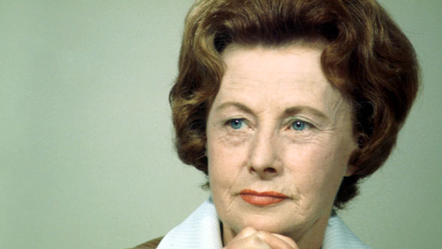
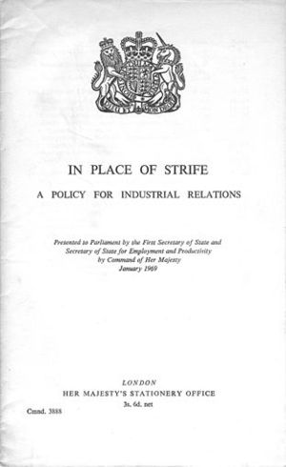
Barbara castle

Slide 3
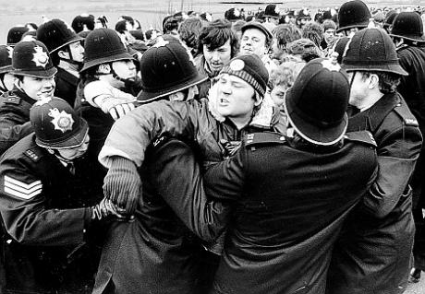
Strikes … and more strikes
A wildcat strike is a strike action which is undertaken while a union contract is still in effect, or while a union is negotiating for benefits. Since a wildcat strike is not authorized by a union, it is technically an illegal action. In most countries, employees who participate in a wildcat strike can be dismissed without legal repercussions for the company. Because wildcat strikes are not legally protected, most workers try to avoid them
http://www.wisegeek.com/what-is-a-wildcat-strike.htm.

Slide 4
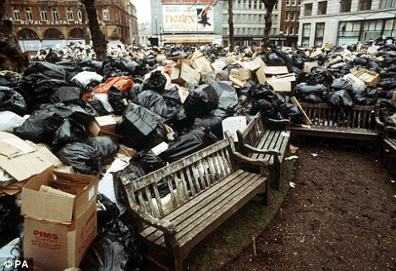
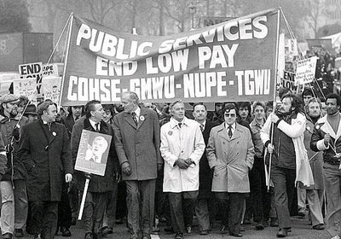
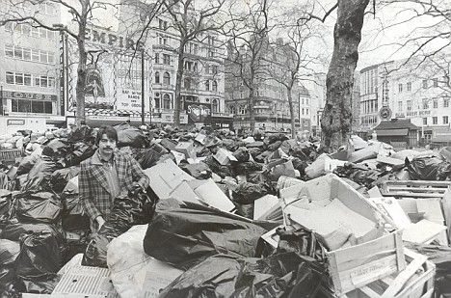
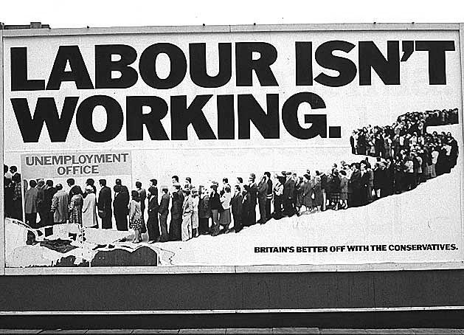
Winter of discontent

Slide 5
The 1973 ENERGY CRISIS
The Kippur war between Israel and the Arab countries from October 6 to 16, 1973. During this war and in the following months, the oil producing Arab countries successfully wielded the weapon represented by their oil resources. They notably placed an embargo, for several months, on exports to countries which were branded "enemies of the Arab cause" - including practically all the countries of Western Europe - while reducing their overall oil output level. They decided to overturn the principle of price setting for crude oil through agreements with the oil companies and hiked up prices on a unilateral basis. Finally, they stepped up their claims to holdings in the companies producing crude oil. Under the combined impact of these measures, oil prices quadrupled in just a few months. In the Member States, the first effect of the crisis was a shortage of oil, which led to a number of measures to restrict consumption (no use of cars on Sundays, speed limits, heating restrictions and so on). As shortage fears diminished, prices and their financial consequences became the uppermost concern. Although supply difficulties tailed off after December 1973, the prices for crude oil kept growing to reach twelve times their pre-crisis level (36 dollars the barrel compared to 3) . This abrupt increase in crude oil prices in the space of six years dealt a devastating blow to the economies in several regions of the world, including Europe. The Community Member States, accustomed to trade surpluses, saw these frittered away into a deficit situation. Recession began to bite in nearly all the European countries and gave rise to what was termed "Euro-stagnation" or "Euro- slump" . http://www.europedia.moussis.eu/books/Book_2/6/19/01/01/?all=1

Slide 6
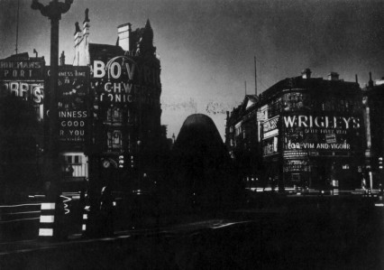
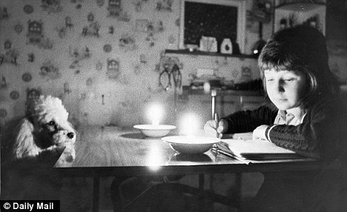
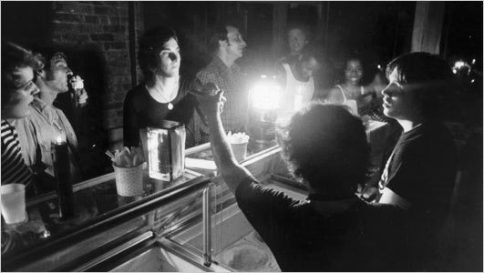
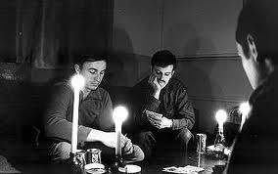
Blackout Britain

Slide 7
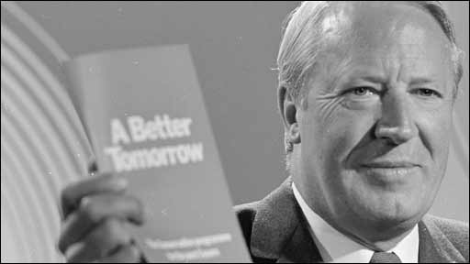
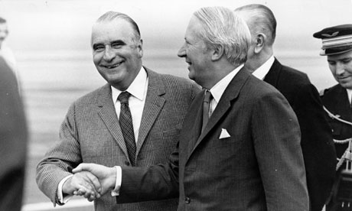
PM Ted Heath
A self-made Conservative politician
From a modest family in Kent
Went to study at Oxford
Accomplished organ player and yachtsman
As opposed to the Tory grandees or Labour socialists - he championed a modern, meritocratic, free-market society

Slide 9
Heath’s Euro-enthusiasm
Heath – had a great passion for Europe and its culture, no interest in the Commonwealth
1963: there were “We in Britain are not going to turn our backs on the mainland of Europe or on the countries of the Community. We are a part of Europe: by geography, tradition, history, culture and civilisation. We shall continue to work with all our friends in Europe for the true unity and strength of this continent.” (Sandbrook: A State of Emergency , 137)

Slide 10
Briton’s attitudes to Europe
Positive
Adopting European food and drink (Italian and Greed cuisine, wine)
Popularity for European holidays (most typical destination: Costa Brava).
European music (Abba)
Negative
Fears among the working class that Europe will undermine British socialism
“By the early 1970s, this had evolved into the firm belief that the Common Market was a millionaires’ conspiracy, destined to crush British socialism for ever. This was, after all, an age in which there was no dirtier word in the socialist lexicon than “multinational” (Sandbrook, 155)

Slide 11
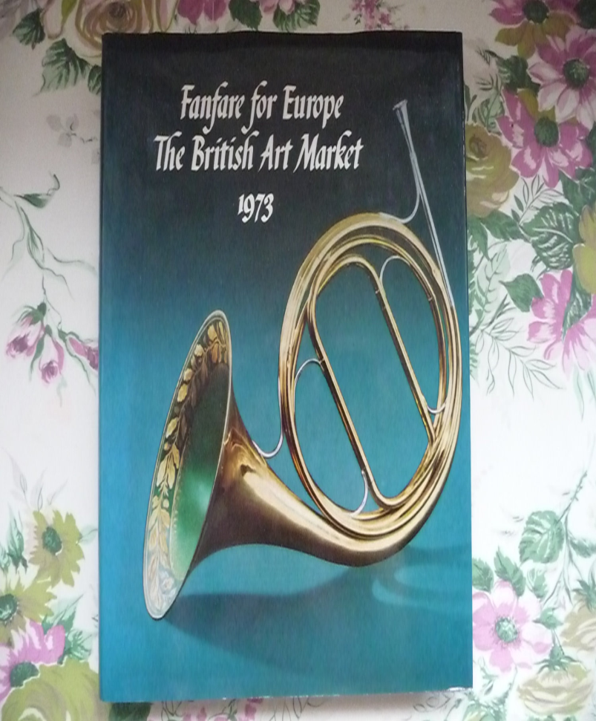
Britain joins the EEC
1972 - Heath – manages to negotiate accession to the EEC with the French President Pompidou
Official membership – from January 1973
> his greatest political success
A massive pro-European campaign – backed by most of British press
People – largely indifferent, no enthusiasm about the membership

Slide 12
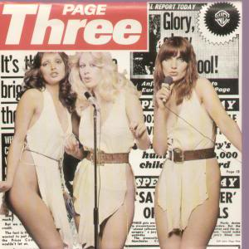
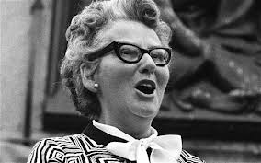
Permissive society x conservative voices
Page 3 girls
Mary Whitehouse

