Slide 1
QA @ Kerio Technologies
From Waterfall to Continuous Delivery
Zdeněk Samuel, QA Manager

Slide 2
About

Slide 3







Products @ Kerio
Notes:
Kerio Connect (~45 000 active installations)
Kerio Control (~24 000 active installations) + HW
Kerio Operator (since January 2011) + HW
Samepage – collaboration tool in cloud

Slide 4












Multi-platform Development
Notes:
Different OS
Linuxes
Internet browsers
Varied world of mobile devices …
Platform dependent bugs

Slide 5
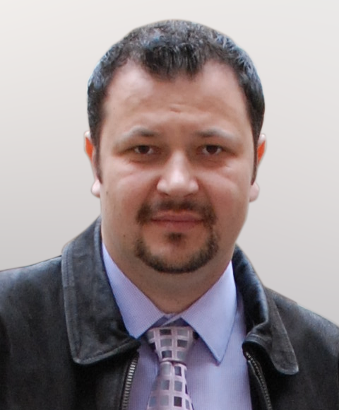
About myself
QA manager – member of the Product Management group
  Quality Assurance
  Lead the QA
  Speaker at CzechTest 2013 conference
Team leader of testers
Technical support engineer
12 years in Kerio

Slide 6
Our journey

Slide 7
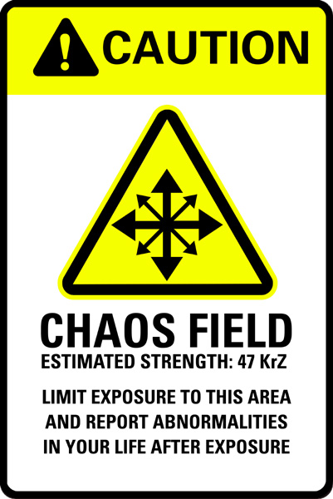
Before QA
QA
Methodologies
Focus on quality
Philosophy
  Quality
  Simple
  Stable
  Secure
  SMB
  Channel
Notes:
Stav před QA:
žádné plánování, žádná metodika, žádné testování
Release, kdy nás napadl
agilita? Ne, chaos!
Mizerná kvalita produktu – zhoršující se tendence s novými lidmi
CVS

Slide 8
Methodologies @ Kerio
Waterfall
MSF
Agile
Continuous Delivery
Notes:
Vodopad:
plánování, specifikace, kódování, testování
Gant chart, specifikace
Opravily se největší problémy a vydalo se – bugy se kupily
Zdržení projektů

Slide 9
Waterfall @ Kerio
Planning → Specification → Coding → Testing
Gant chart, specifications
Only the most serious bugs fixed
  Increased amount of bugs
  Delaying projects

Slide 10
Bugzilla process
Reporting
Solution
Verification
Steps to reproduce
Severity vs. Priority
Flags / Keywords
Customer counts
Response time
Triage
Target Milestone
Resolution
Verified
Can’t / Won’t verify
Notes:
- Impact, triage, TM

Slide 11

Acceptance tests
Is product releaseable?
Test cases are grouped in test suites
Tester says yes/no
Test protocol – accessible to whole company
TestRunner
  Own test management tool
  Testers can collaborate
  Web based application
Notes:
- Podklady pro rozhodovani o releasu

Slide 12
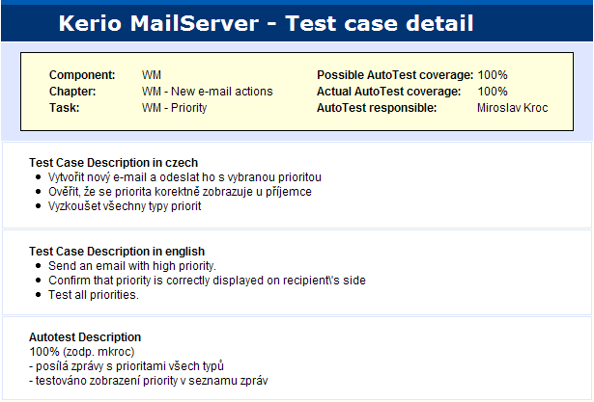
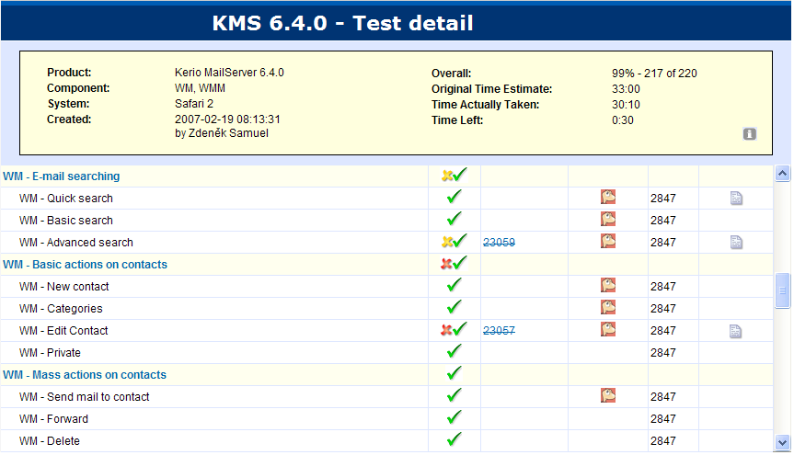
TestRunner

Slide 13

Test techniques
Open eyes and just harvest bugs!
Black-Box testing
  According to specification
  Installation packages (1 build / 2 – 3 weeks)
  Bugs verification
Notes:
Nebylo příliš složité
Bugy, kam se člověk podíval

Slide 14

Beta Testing
Motivation
  Different types of people
  Different environments
  Limited resources
Challenges
  How to get new members
  How to motivate them
  How to communicate
  How to simplify testing
Feedback
  Functionality
  Prioritization
  Design
  Use cases
  Messaging

Slide 15
Waterfall summary
Waterfall
MSF
Agile
Continuous Delivery
Code repository
Bugzilla process
Acceptance tests
Beta testing
Notes:
Waterfall summary
Microsoft Soltion Framework
Největší pokrok

Slide 16
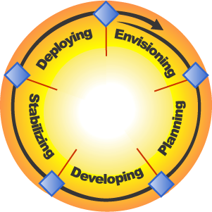
Microsoft Solution Framework
Deployment
Complete
Release Readiness
Approved
Vision/Scope Approved
MSF
Scope Complete
Project Plans Approved
Notes:
Když podle toho jede MS, tak to přeci musí fungovat
Iterativní model
QA zahrnuté téměř v každém kroku
Buildy už ne na konci vývoje ale průběžně
Revoluční model pro Kerio – nejvíce změn

Slide 17
Development and Testing in MSF
QA involved since planning phase
  + white box testing
New features
  Incremental builds
    Autobuild
      AutoTest
Stabilization phase
  Restrictive commits, Semaphore
  Code review
  Acceptance tests

Slide 18

Autobuild system @ Kerio
Regularly builds new versions from source code
Developer knows if his commit contains any fatal error
QA has a build with all repairs
Vitally important system
Unsuccessful build = urgent priority to fix it
How to force developers to fix
broken build?

Slide 19
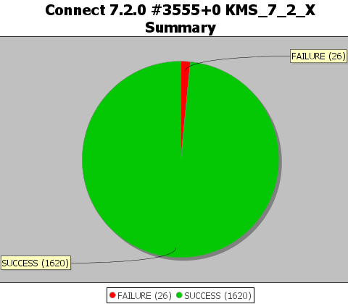
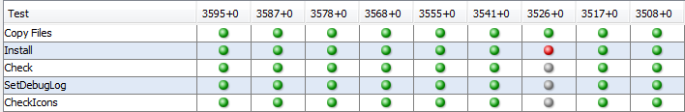
AutoTest Framework @ Kerio
Java application
Virtualization
Multiplatform
Extendable
Tests planning
Statistics / trends
Regression tests
…
Notes:
Jak jsme vybírali AT?: open-source vs. Komerční
Na web Wats -> Selenium
Když je rozbitý test, platí to samé jako u AB

Slide 20






AutoBuild/Test framework
Code
Package
Packages
Scripts
Package
Config.
Test suites
Results

Slide 21
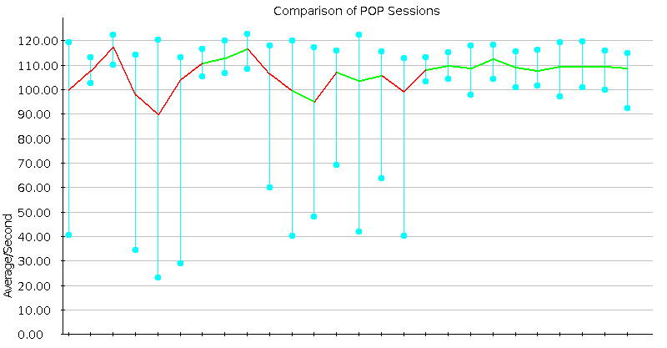


Performance tests @ Kerio
Maximum firewall’s throughput
HW requirements for X clients
Synchronization time
Slamd, Avalanche - with night builds

Slide 22
Other techniques
Updates monitoring and compatibility tests
  New versions of 3rd-patry sw
  Test of platform-dependant features (installation, ssl, authentication, …)
Release tests
  Web, update checker
Virtualization
  Increasing testability

Slide 23
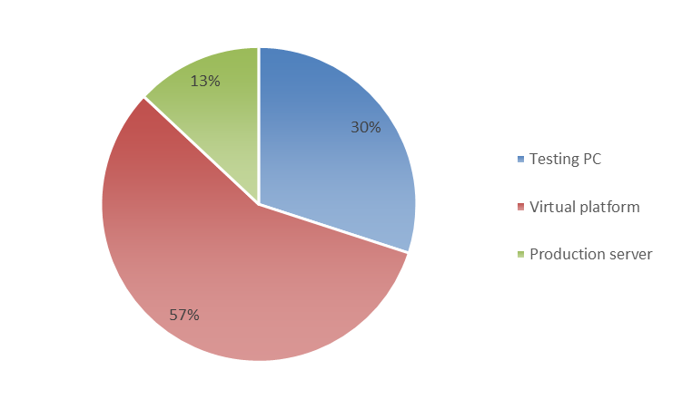
Testing platforms
Notes:
- Virtual is absolutely major

Slide 24
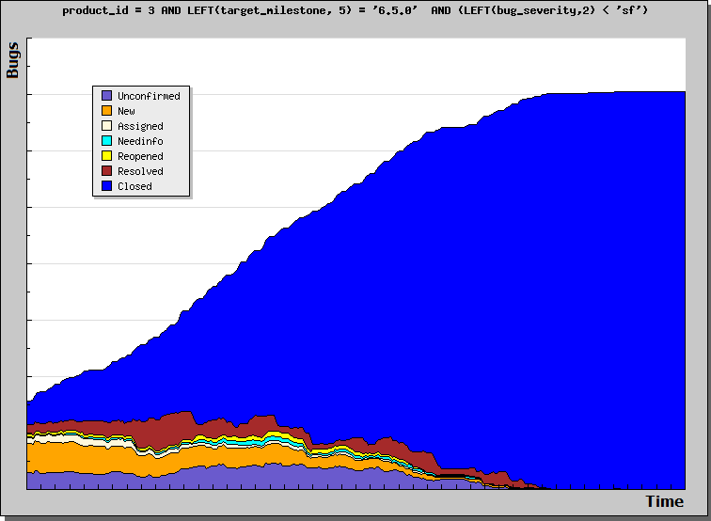
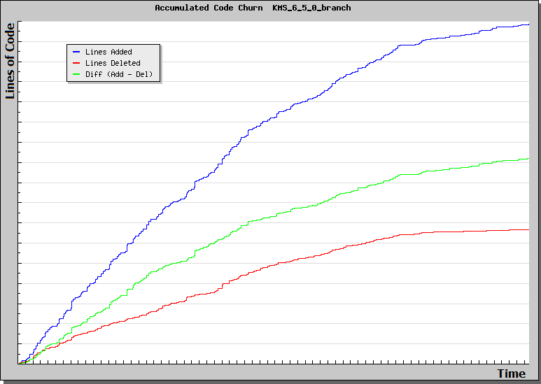
Project monitoring

Slide 25
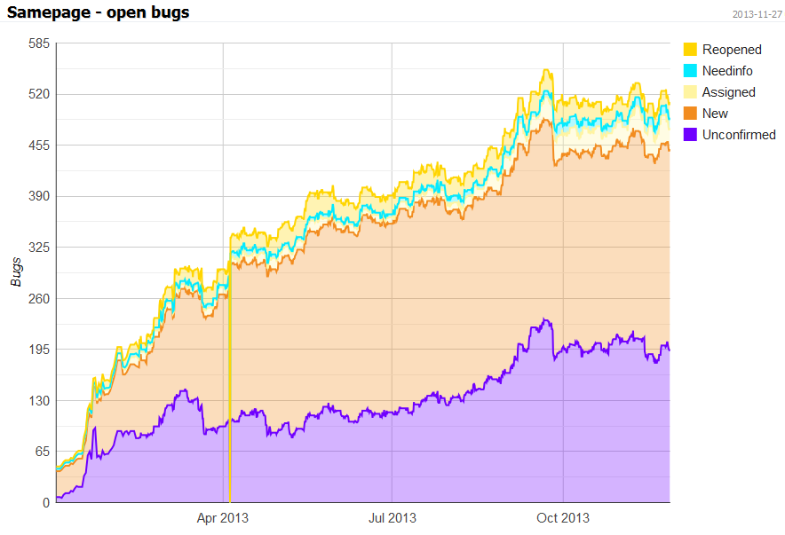
Product monitoring

Slide 26

Internal Testing @ Kerio
Notes:
Častější buildy k nasazování na interní servery
Různé typy lidí

Slide 27
Internal Testing Principles
We use our own products
Managed by QA
Maximize different environments
Eliminate barriers for reporting
Not override bugs
Server’s multi-leveling
Notes:
Address issues not ICT but to QA
Advantages:
diff. approach, IT crowd, solving problem vs analysis
Centralized bugs, overview
Don’t hinder others
Distributed devices with diff. platforms, boss
Bugzila vs. emails, calls
Encourage to report
Server applications
Three categories of servers

Slide 28

Field Testing @ Kerio
Unique process
8 – 12 customers with different environments
RC and final versions in customer’s environment
Postponed release
No active testing, just using
Monitoring
Notes:
Supplementary program for beta testing
Small group of partners
Essence in diversity
From update checker
To cover all common combinations
Monitoring of performance characteristics

Slide 29
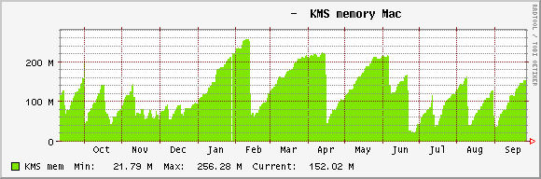
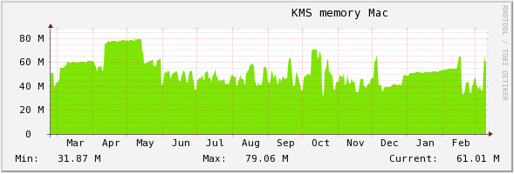
FT Monitoring
Notes:
Picture one
Five years ago
Spike = memory leak and restart
Picture two
Current state on the same server

Slide 30

End user participation
Data collection
  Crash reports
  Update checker
  Voluntary statistics
Feedback collection

Slide 31




4 Levels of Community Testing
Internal Testing
Beta Testing
Field Testing
End User Participation
Notes:
Internal Testing
Easy access to data
Beta Testing
Motivate partners
Focus on what you want to get
Field Testing
Emergency brake
End User Participation
Don’t underestimate their contribution

Slide 32
MSF summary
Waterfall
MSF
Agile
Continuous Delivery
Code repository
Bugzilla process
Acceptance tests
Beta testing
AutoBuild
Autotest
Semaphore
Code review
Project monitoring
Performance tests
Community test.
Virtualization
Notes:
Waterfall summary
Microsoft Solution Framework
Největší pokrok

Slide 33





Agile development @ Kerio
Feature driven development → Date driven development
CVS → GIT, development in branches
Regular automatic (hourly) builds / tests
Regular betas
Pair programming
We use “Scrum”
24 hours
Sprint
2-4 weeks
Feature 1
Feature 2
Sprint goal
Feature 3
Feature 1
Sprint backlog
Product backlog
Potentially shippable
product increment
Notes:
Train model
Není SCRUM na 100%
Není scrum master, zákazník
Je: plánování, stand-upy, scrum board, retrospektivy, post-mortem

Slide 34
Agile testing
Tester’s roles and responsibilities
  Member of SCRUM team (but still independent)
  Participate on all ceremonies
  Participate on design
  Create verification / acceptance criteria (test cases)
  Test all features
  Using daily / hourly builds
Exploratory testing
  An approach in software testing with simultaneous learning, test design and test execution
  Requirements or specifications are incomplete

Slide 35
Agile testing
Acceptance / validation criteria
  User stories
  Instead of specifications
  Acceptance tests – done / not done
Test design
  The new test cases are created for acceptance / regression automatic tests
Functional tests
  Black & White box testing
  Stories, installation packages

Slide 36

Stabilization phase
Not really agile
Starts with feature complete beta
Restricted commits to GIT
Testing in stabilization phase
  Bugs verification
  Acceptance / regression tests
  Beta testing, Field-Testing
  System tests
GO! / NO GO!

Slide 37
Agile summary
Waterfall
MSF
Agile
Continuous Delivery
Code repository
Bugzilla process
Acceptance tests
Beta testing
AutoBuild
Autotest
Semaphore
Code review
Project monitoring
Performance tests
Community test.
Virtualization
Date driven dev.
GIT, branches
Hourly builds
Train model
Exploratory tests
GO / NO GO
Agile company
Notes:
Waterfall summary
Microsoft Soltion Framework
Největší pokrok

Slide 38

Samepage
New delivery principles
  Cloud application
  Start-up mode
  Quick changes
  Short Time-To-Market
  Integration
  CONTINUOUS DELIVERY
Notes:
Cloud app = high availability service
Integration = cloud units, business

Slide 39
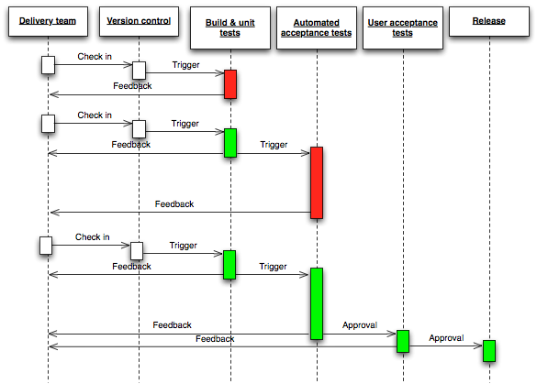
Notes:
Včetně deploymentu
Od feature až po bugu
Žádnej roll-back
Podmínkou je maximální možná modularita

Slide 40
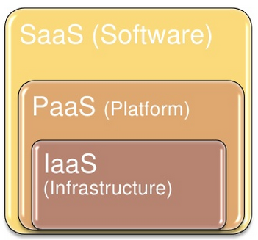
Testing of cloud application
We own whole cloud
Product vs. Operational quality
Notes:
SaaS – Similar to testing on-prem apps.
+ Functionality, Compatibility, Usability, Security, API, Performance, Multi-tenancy, Availability, Business processes
- multiplatform support, multiple version upgrade, backward compatibility
PaaS:
Integration, Functionality of cloud units, Performance of each units, Versioning (compatibility of cloud units), Deployment, Data integrity, Latency tests (in case of more geo. locations), Units monitoring
IaaS:
HW monitoring, HW connectivity (add/remove some hw), Recovery test, Disaster recovery tests

Slide 41

Infrastructure as a Service
Testing environment
  QA cloud
  Pre-production cloud
  All-In-One environment
HW monitoring: Zabbix
IaaS tests
  HW connectivity
  Recovery, disaster recovery
Notes:
SaaS – Similar to testing on-prem apps.
+ Functionality, Compatibility, Usability, Security, API, Performance, Multi-tenancy, Availability, Business processes
- multiplatform support, multiple version upgrade, backward compatibility
PaaS:
Integration, Functionality of cloud units, Performance of each units, Versioning (compatibility of cloud units), Deployment, Data integrity, Latency tests (in case of more geo. locations), Units monitoring
IaaS:
HW monitoring, HW connectivity (add/remove some hw), Recovery test, Disaster recovery tests

Slide 42
Platform as a Service
Integration and functionality of cloud units
  Registration to Zookeper
  Backup, Data replication
Deployment
  Deployment steps
  Tests after each step
  DB updates
Monitoring of cloud units
Notes:
PaaS:
Integration, Functionality of cloud units, Performance of each units, Versioning (compatibility of cloud units), Deployment, Data integrity, Latency tests (in case of more geo. locations), Units monitoring

Slide 43
Software as a Service
Similar to on-prem
  Functionality
  Compatibility
  Security
  Usability
  Performance
  API
  Bugs verification
  Regression
  Automation
New tests
  Availability
  Multi-Tenancy
  Business processes
Obsolete tests
  Multiplatform support
  Multiple version upgrade
  Backward compatibility
Notes:
SaaS – Similar to testing on-prem apps.
+ Functionality, Compatibility, Usability, Security, API, Performance, Multi-tenancy, Availability, Business processes
- multiplatform support, multiple version upgrade, backward compatibility

Slide 44
SaaS – New Features
Feature flag
  Deliver unfinished features from master branch
  Partial deployment: Kerio, SEA
  Importance of regression tests
  Marketing campaigns
Automation
  Incremental builds
  Unit and integration tests for new features
  Regression tests (deployment)
Agile approach

Slide 45

Continues Delivery @ Kerio
Release cycle:
  2 weeks → 1 week
  TTM: 3 – 8 days
Current state
  Incremental builds
  Insufficient splitting into small SW units
  Poor test coverage
  Semi-automatic deployment with short outage
Integration in development
  RedMine → Bugzilla → GIT → Phabricator → TeamCity → Unit tests → Deployment → AutoTest

Slide 46


Slide 47
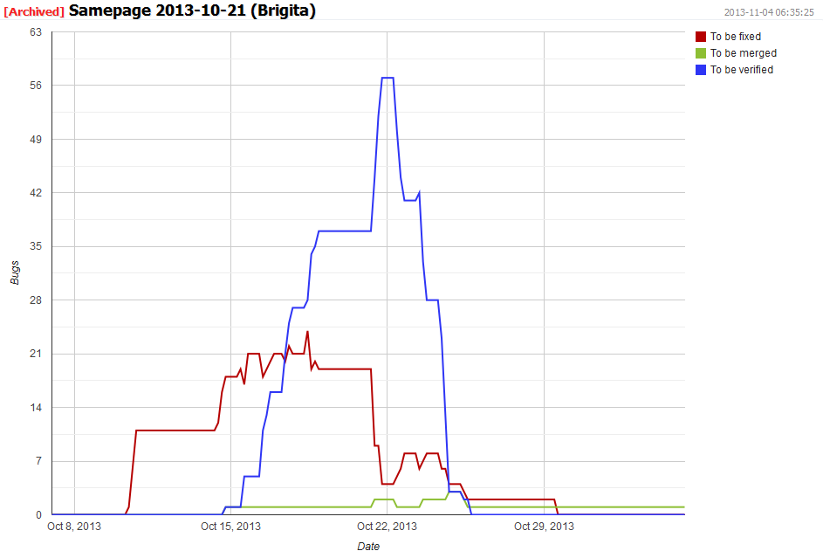

Release cycle

Slide 48
Continuous Delivery Summary
Waterfall
MSF
Agile
Continuous Delivery
Code repository
Bugzilla process
Acceptance tests
Beta testing
AutoBuild
Autotest
Semaphore
Code review
Project monitoring
Performance tests
Community test.
Virtualization
Date driven dev.
GIT, branches
Hourly builds
Train model
Exploratory tests
GO / NO GO
(On-prem)
Testing cloud, All-In-one env.
Incremental builds
Integration in dev.
Deployment tests
Cloud monitoring
Feature flags
Automation
Notes:
Waterfall summary
Microsoft Soltion Framework
Největší pokrok

Slide 49
QA activities @ Kerio
Code repository
Bugzilla process
Acceptance tests
Beta testing
AutoBuild
Autotest
Semaphore
Code review
Project monitoring
Performance tests
Community test.
Virtualization
Date driven dev.
GIT, branches
Hourly builds
Train model
Exploratory tests
GO / NO GO
(On-prem)
Testing cloud, All-In-one env.
Incremental builds
Integration in dev.
Deployment tests
Cloud monitoring
Feature flags
Automation
Notes:
Waterfall summary
Microsoft Soltion Framework
Největší pokrok

Slide 50
Results

Slide 51

Questions?

Slide 52

Thank you for attention
Zdeněk Samuel
QA manager
zsamuel@kerio.com
Kerio Technologies
Sources:
  Scrum diagram by
  Continuous delivery
Notes:
That’s all. Thank for attention! Have a nice day.

Slide 53
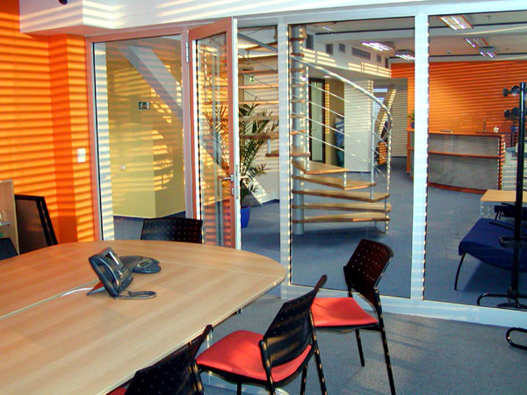

Kerio invitation
Kerio Technologies s.r.o.
Anglické nábřeží 1
301 49 Plzeň
info@kerio.cz
www.kerio.cz

